Slide 1
How did life begin? Evolution

Slide 2
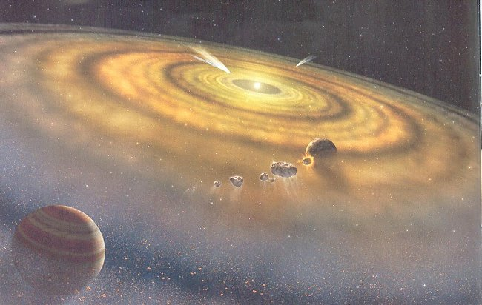
1. How did Earth start?
A. No oxygen
B. Oldest fossils are thought to be anaerobic, heterotrophic prokaryotes
C. Food from spontaneously formed molecules
C. Autotrophs – better off
D. Archaea
http://www.youtube.com/watch?v=VOz4PkdY7aA

Slide 3
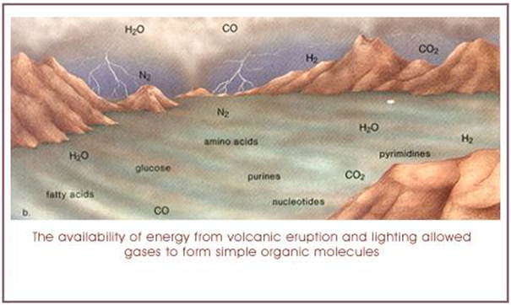
2. What is the origin of simple organic compounds?
A. Many hypotheses
B. have existed on earth forever?
C. Carried to Earth by debris?

Slide 4
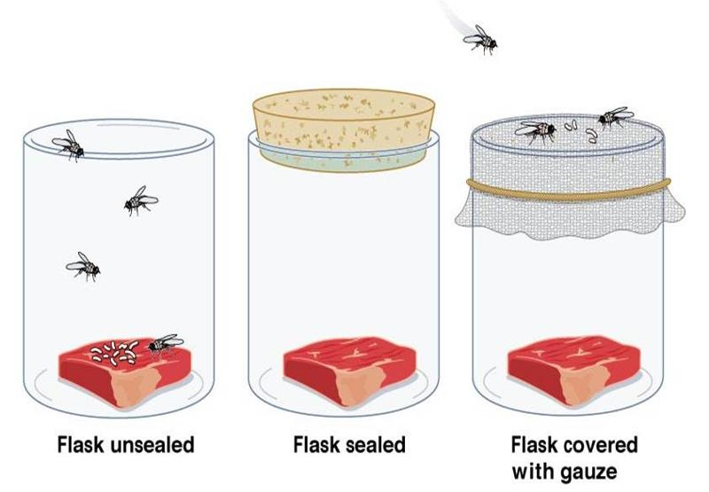
3. What were Early Experiments trying to prove?
A. Biogenesis (living things come from other living things) Vs Spontaneous generation – before 17th century
B. Redi’s Experiment maggots
C. Spallanzani’s – meat broth
D. Pasteur – flasks
E. Miller & Urey
http://www.youtube.com/watch?v=WNByRghR6sw
http://www.youtube.com/watch?v=63IoOLXmzKg - all three

Slide 5
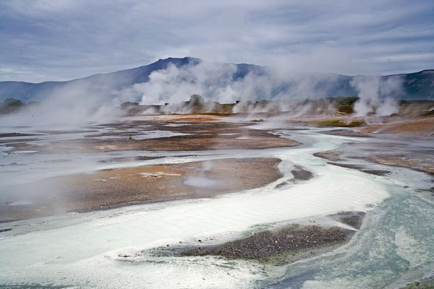
4. Where did the first cells come from?
Research by Sidney Fox (1912-1998)
A. Saw cell-like structures form spontaneously from simple chemicals
B. Microspheres-spherical with many protein molecules-membranes
C. Coacervates – droplets of molecules of lipids, amino acids, and sugars
D. No hereditary information

Slide 6
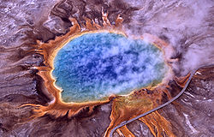
5. Why Archaea?
A. Can thrive under extremely harsh conditions
B. Unicellular
C. Most are autotrophs
D. Breathe sulfur
E. Obtain energy by chemosynthesis – oxidation of sulfur and carbon dioxide

Slide 7
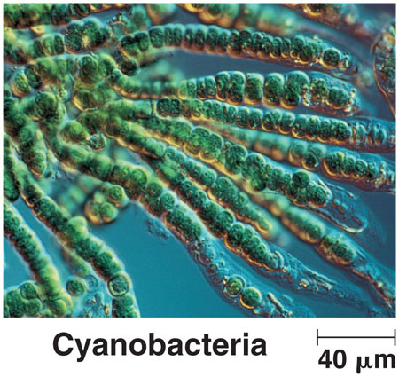
6. Cyanobacteria
A. Cyanobacteria is similar to organisms from 3.5 billion years ago
B photosynthetic unicellular
C Found in fossils
D. Theory proposes than cyanobacteria became chloroplasts in eukaryotes – has DNA in it

Slide 8
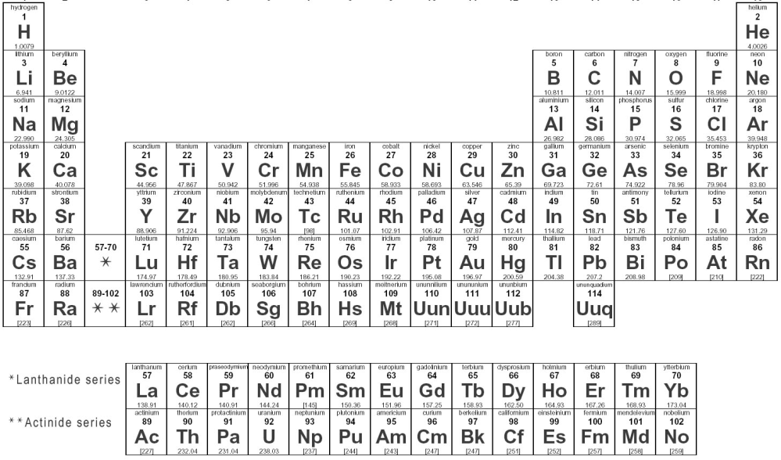
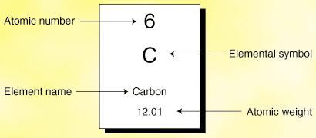
7. How do you find the age of fossils?
A. Radiometric Dating
B. Use isotopes
C. Ex. Carbon
D. C–14 vs C-12
E. What is different?
F. # of neutrons
G. Unstable + radioactive

Slide 9
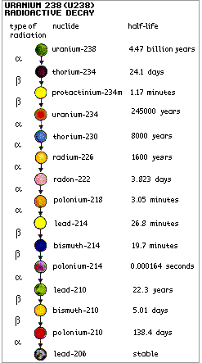
8. How to find the ½ life of C-14
A. Half-life = length of time it takes for ½ of any sample to decay to its stable form
B. Compare C-14 to C-12
C.When an organism dies – uptake of carbon stops
D. Existing C-14 still continues to decay
E. After 5,730 years, ½ remains
F. Works if organism is less than 60,000 years old

Slide 10
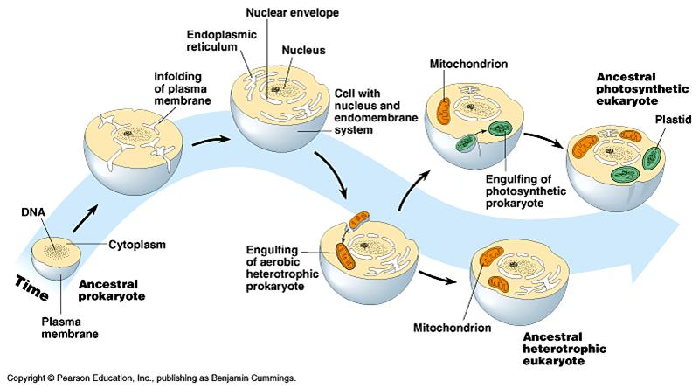
9. What is Endosymbiosis and what does it have to do with the first eukaryotes?
A. Theory
B. Between 2 billion and 1.5 billion years ago
C. Think a small aerobic prokaryote was engulfed in a larger anaerobic prokaryote making a eukaryote
and started dividing – called endosymbiosis
D. Think that aerobic prokaryotes became mitochondria – has DNA in it

